Slide 1

Using Corticomuscular Coherence to Assess Cortical Contribution to Walking Gait in Patients with Parkinson’s Disease
Supervised by :
1. Prof. Dr. Natasha M. Maurits
2. Ms. Joyce B. Weersink
University Medical Center Groningen
Presented by :
Alok Ranjan
Date : 01 Aug 2019

Slide 2
Outline
Introduction
Participants
Task and experiment
Data and pre-processing
Analysis
Discussion
Conclusion
Future work

Slide 3

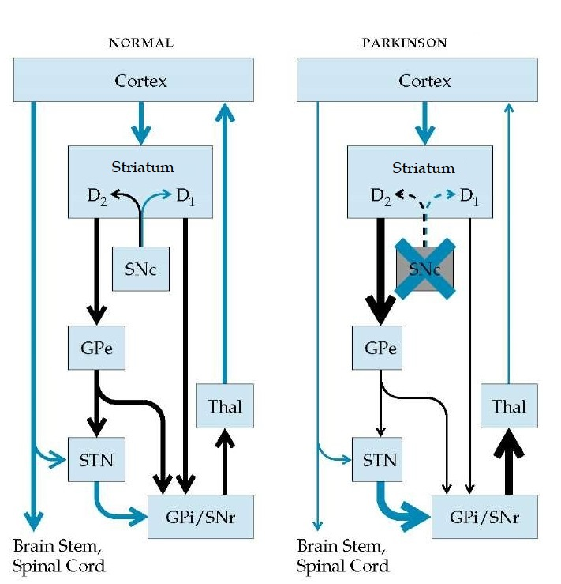
Introduction
Locomotion
Quadrupedal locomotion
Rhythmic motion
Activity in hip extensors
( During most of the stance phase)
Generated by spinal networks
Central Pattern Generators and Reflexors
Bipedal locomotion
Forward propulsion
Activity in planter flexor muscle
( During Stance and push-off phase)
Re-organization of the central network involved
Parkinson’s Disease
Dopamine depletion in the striatum
Decreased cortical projection to cortex and brain
Figure: Wiring of the basal ganglia, left : normal situation, right: abnormal situation in Parkinson’s disease. Courtesy of http://what-when-how.com
Notes:
SNc= Substantia nigra pars compacta, STN= sub thalamus nucleus, GPi= Globus Pallidus, GPe= Globus Pallidus exrema

Slide 4
Introduction
PD, decreased activation in SMA
Reduced step length and loss of arm swing
Opposite limb co-ordination and movement initiation
Contribution of M1 and SMA in walking gait
Is M1 involved in leg muscle activation during gait?
Is the SMA, directly or indirectly through M1, involved in the activation of leg muscles during gait?
Are SMA and M1 involved in activation of arm muscles during gait related arm swing?
EEG- EMG and finding correlations

Slide 5

Participants
Control group (C)
10 males and 10 females
Median age 69 years
Interquartile range 4.25 year
Parkinson’s Disease Group (PD)
13 males and 7 females
Median age 67.5 years
Interquartile range 11.25 years

Slide 6

Task and Experiment
Control group walking normal (C_WN) : 20
Control group walking with enhanced arm swing (C_WEA): 18
Parkinson disease group walking normal (PD_WN) : 20
Parkinson disease group walking with enhanced arm swing (PD_WEA): 19
EEG- 10-20 system, 32 Ag-AgCl electrodes, Active electrodes ,512 Hz
EMG- 14 Bipolar electrodes (TA, S, RF, BF, DA, DP) ,512 Hz
Heel Strike- Tri-axial accelerometer

Slide 7

Data and Pre Processing
EMG- TA, RF, DA
Downsampled to 256 Hz,
High pass filter: ‘highpass’ 5Hz, compensates for the delay
EEG- Cz, Fz, D4
Downsampled to 256 Hz,
High pass filter: FIR 1 Hz, compensates for the delay
Line noise removal: 50 Hz, 100 Hz,
Motion artefact cleaning

Slide 8

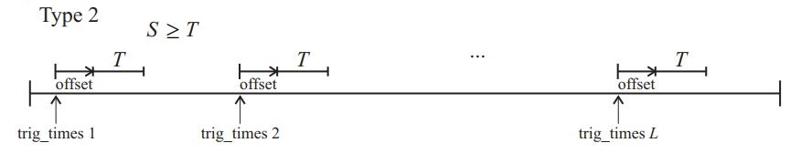
Analysis
EEG-EMG segments (Type 2, S≥T)
Auto spectra f_{xx} (λ) and f_{yy} (λ)
Cross spectra f_{xy} (λ)
Coherency and Coherence
Phase [-π, π]
Cumulant density
95% confidence interval : variance
Both ‘detrended’, EMG ‘rectified’
Figure : Illustration of Type 2 analysis in NeuroSpec
(http://www.neurospec.org/)

Slide 9
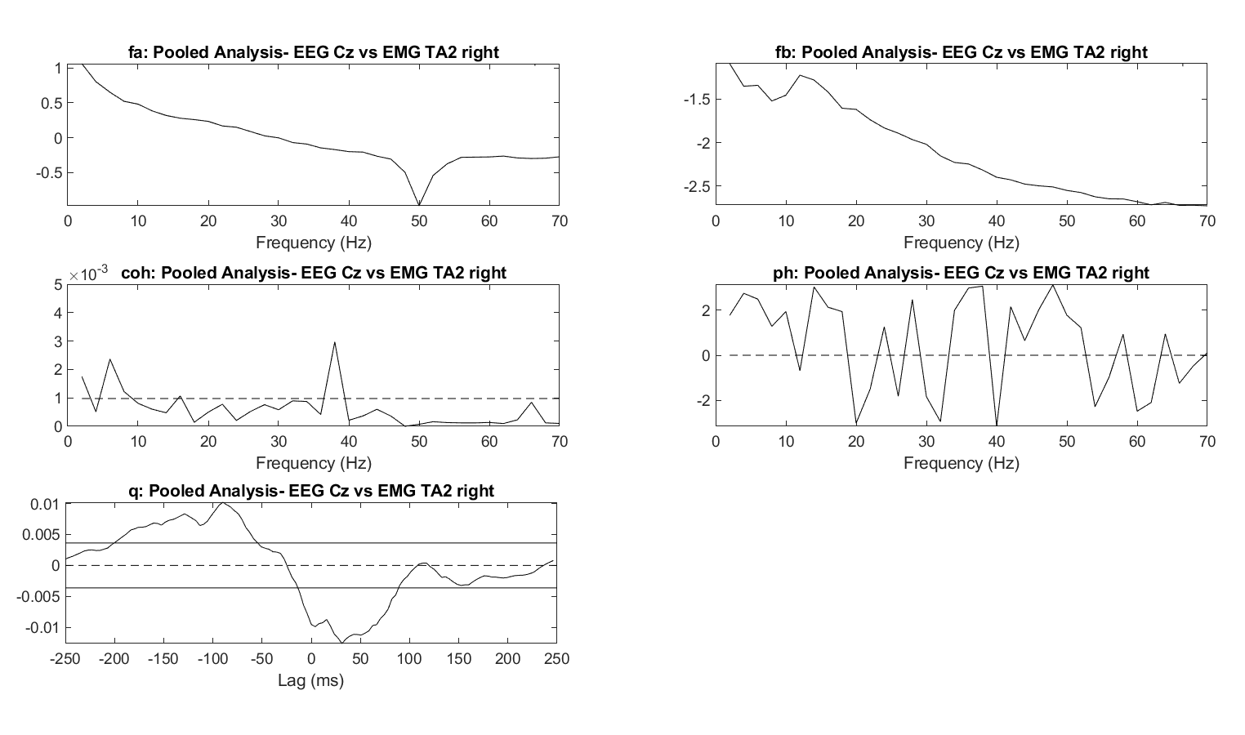
Time Independent Analysis
Maximum muscle activation duration
TA (from -550 ms to -50 ms)
RF (from -1100 ms to -600 ms)
DA (from -950 ms to -450 ms)
Segment length: 128 ms (S=7)
Frequency resolution : 2 Hz
Figure : Shows pooled estimates of corticomuscular coupling parameters for C_WN, i.e. EEG spectra (top-left), EMG spectra (top-right), coherence (middle-left), phase (middle-right), cumulant density (bottom-left), for cortical region Cz and muscle TA of right leg and between offset -550 ms to 0 ms.

Slide 10
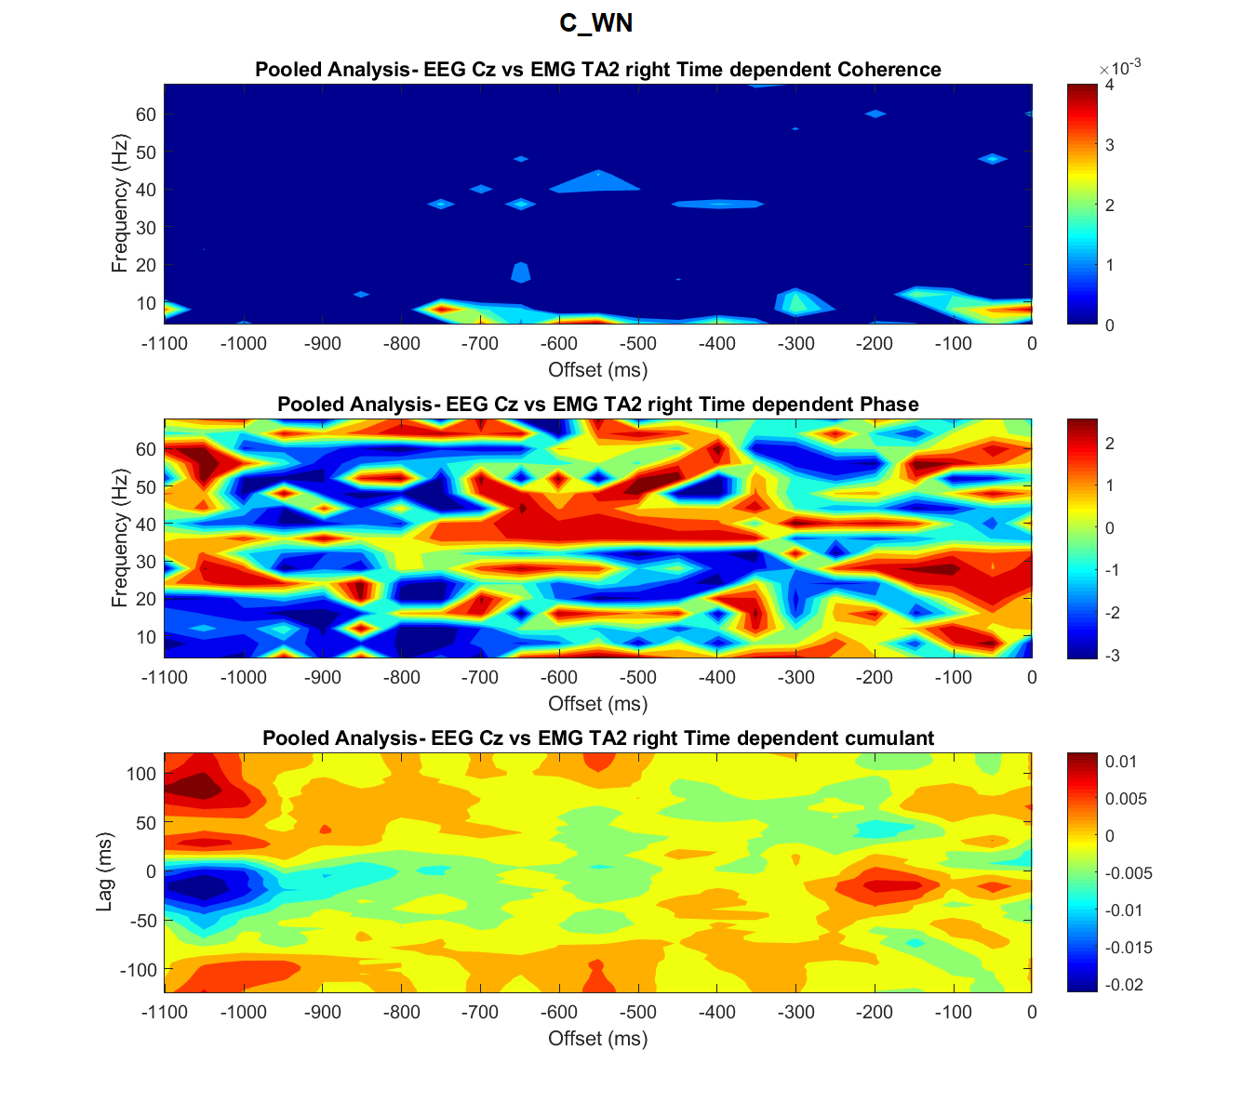
Time Dependent Analysis
A full gait cycle (from -1100 ms to 0 ms)
Segment length: 64 points
Resolution in frequency domain : 4Hz
Resolution in time domain : 50 ms
Matrix representation (24x23)
95% CI, mask_flag=1
Heatmap representation
Figure : Shows T_{d} estimates of corticomuscular coupling parameters for C_WN, i.e. coherence (top), phase (middle), cumulant density (bottom) for cortical region Cz and muscle TA of the right leg.

Slide 11
Time Dependent Analysis
. | . | . | . | . | . | . | . | . | . | . | . | . | . | . | . | . | . | . | . | . | .
. | . | . | . | . | . | . | . | . | . | . | . | . | . | . | . | . | . | . | . | . | .
. | . | . | . | . | . | . | . | . | . | . | . | . | . | . | . | . | . | . | . | . | .
. | . | . | . | . | . | . | . | . | . | . | . | . | . | . | . | . | . | . | . | . | .
. | . | . | . | . | . | . | . | . | . | . | . | . | . | . | . | . | . | . | . | . | .
. | . | . | . | . | . | . | . | . | . | . | . | . | . | . | . | . | . | . | . | . | .
. | . | . | . | . | . | . | . | . | . | . | . | . | . | . | . | . | . | . | . | . | .
. | . | . | . | . | . | . | . | . | . | . | . | . | . | . | . | . | . | . | . | . | .
. | . | . | . | . | . | . | . | . | . | . | . | . | . | . | . | . | . | . | . | . | .
. | . | . | . | . | . | . | . | . | . | . | . | . | . | . | . | . | . | . | . | . | .
. | . | . | . | . | . | . | . | . | . | . | . | . | . | . | . | . | . | . | . | . | .
. | . | . | . | . | . | . | . | . | . | . | . | . | . | . | . | . | . | . | . | . | .
. | . | . | . | . | . | . | . | . | . | . | . | . | . | . | . | . | . | . | . | . | .
. | . | . | . | . | . | . | . | . | . | . | . | . | . | . | . | . | . | . | . | . | .
. | . | . | . | . | . | . | . | . | . | . | . | . | . | . | . | . | . | . | . | . | .
. | . | . | . | . | . | . | . | . | . | . | . | . | . | . | . | . | . | . | . | . | .
. | . | . | . | . | . | . | . | . | . | . | . | . | . | . | . | . | . | . | . | . | .
. | . | . | . | . | . | . | . | . | . | . | . | . | . | . | . | . | . | . | . | . | .
. | . | . | . | . | . | . | . | . | . | . | . | . | . | . | . | . | . | . | . | . | .
. | . | . | . | . | . | . | . | . | . | . | . | . | . | . | . | . | . | . | . | . | .
. | . | . | . | . | . | . | . | . | . | . | . | . | . | . | . | . | . | . | . | . | .
. | . | . | . | . | . | . | . | . | . | . | . | . | . | . | . | . | . | . | . | . | .
. | . | . | . | . | . | . | . | . | . | . | . | . | . | . | . | . | . | . | . | . | .
. | . | . | . | . | . | . | . | . | . | . | . | . | . | . | . | . | . | . | . | . | .
.
. | . | . | . | . | . | . | . | . | . | . | . | . | . | . | . | . | . | . | . | . | . | . | . | . | . | . | . | . | . | . | . | . | . | . | . | . | . | . | . | . | . | . | . | . | . | . | . | . | . | . | . | . | . | . | . | . | . | . | . | . | . | . | . | . | . | . | . | . | . | . | . | . | . | .
Figure : 1 cell of the matrix, stores average data of 64 points shown on scale
Figure : A 24x 23 matrix, stores average data for each participant

Slide 12
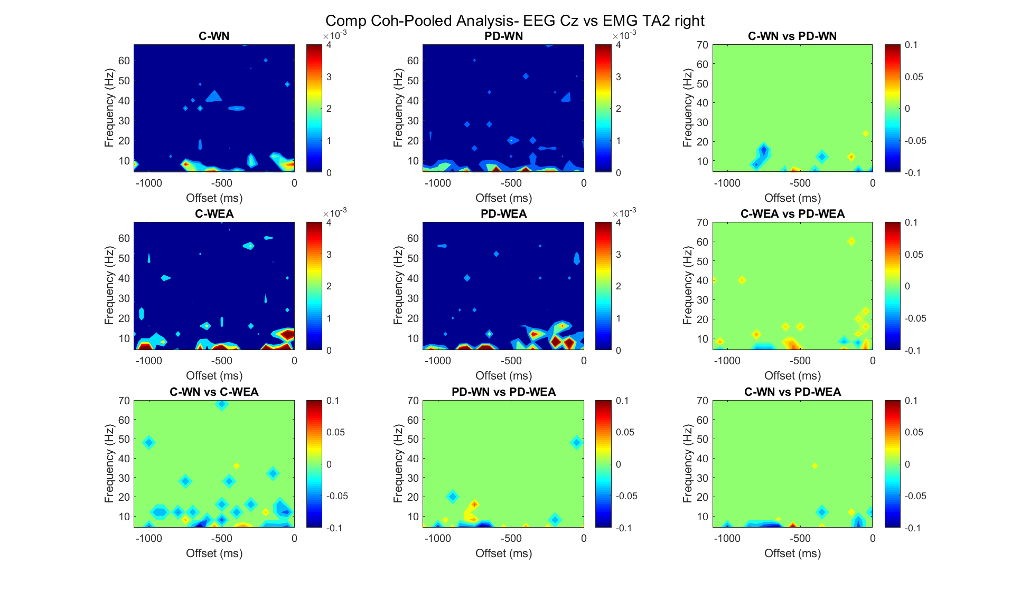
Comparison of Coherence
Fisher’s transform
Tan h⁻¹
Cz vs TA
Fz vs TA
Cz vs RF
Fz vs RF
Fz vs DA
C4 vs DA
Figure : Shows T_{d} comparison of coherences for the four groups for cortical region Cz and muscle TA of the right leg.

Slide 13
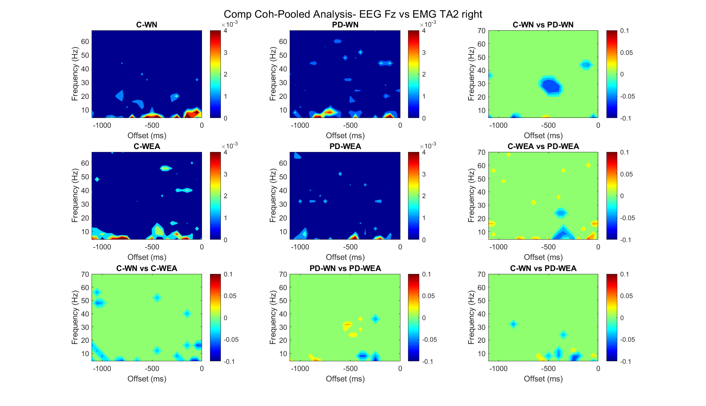
Comparison of Coherence
Fisher’s transform
Tan h⁻¹
Cz vs TA
Fz vs TA
Cz vs RF
Fz vs RF
Fz vs DA
C4 vs DA
Figure : Shows T_{d} comparison of coherences for the four groups for cortical region Fz and muscle TA of the right leg.

Slide 14

Comparison of Coherence
Fisher’s transform
Tan h⁻¹
Cz vs TA
Fz vs TA
Cz vs RF
Fz vs RF
Fz vs DA
C4 vs DA
Figure : Shows T_{d} comparison of coherences for the four groups for cortical region Cz and muscle RF of the right leg.

Slide 15

Comparison of Coherence
Fisher’s transform
Tan h⁻¹
Cz vs TA
Fz vs TA
Cz vs RF
Fz vs RF
Fz vs DA
C4 vs DA
Figure : Shows T_{d} comparison of coherences for the four groups for cortical region Fz and muscle RF of the right leg.

Slide 16

Comparison of Coherence
Fisher’s transform
Tan h⁻¹
Cz vs TA
Fz vs TA
Cz vs RF
Fz vs RF
Fz vs DA
C4 vs DA
Figure : Shows T_{d} comparison of coherences for the four groups for cortical region Fz and muscle DA of the left shoulder.

Slide 17
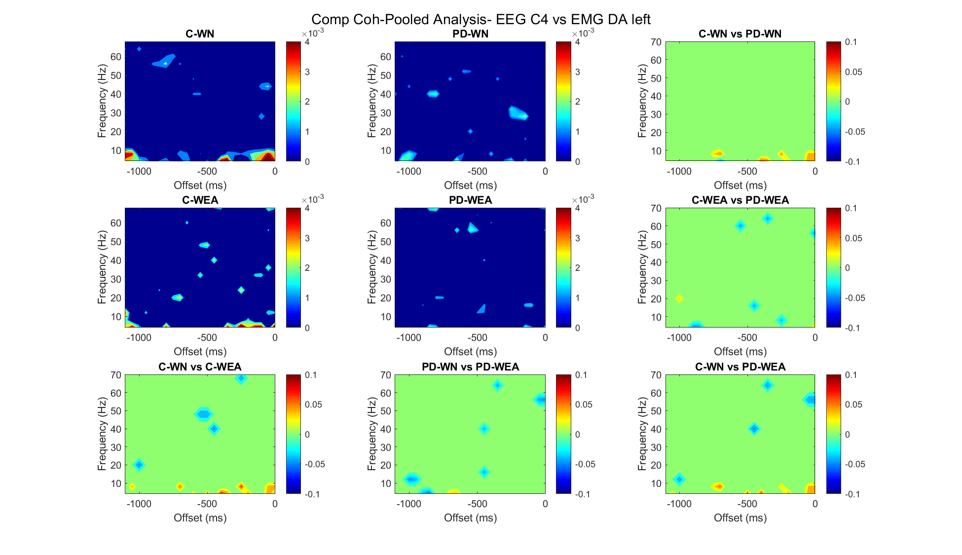
Comparison of Coherence
Fisher’s transform
Tan h⁻¹
Cz vs TA
Fz vs TA
Cz vs RF
Fz vs RF
Fz vs DA
C4 vs DA
Figure : Shows T_{d} comparison of coherences for the four groups for cortical region C4 and muscle DA of the left shoulder.

Slide 18

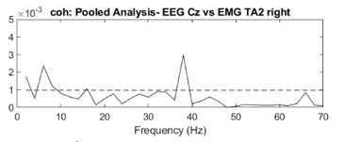
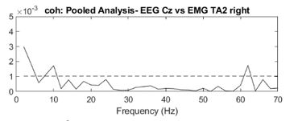
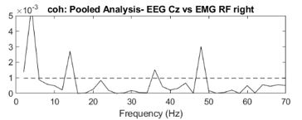
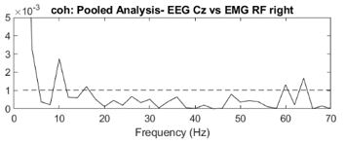
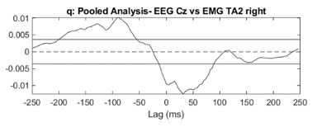
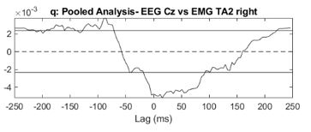
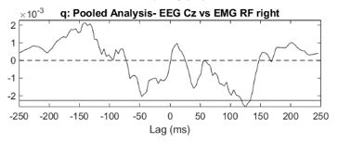
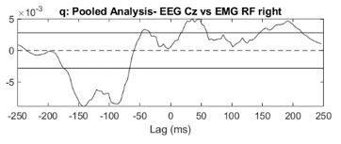
Discussions
Is M1 involved in leg muscle activation during gait?
Cz vs TA and Cz vs RF,
A bi-directional corticomuscular coupling in both T_{ind} and T_{d} analyses
C_WN
PD_WEA

Slide 19
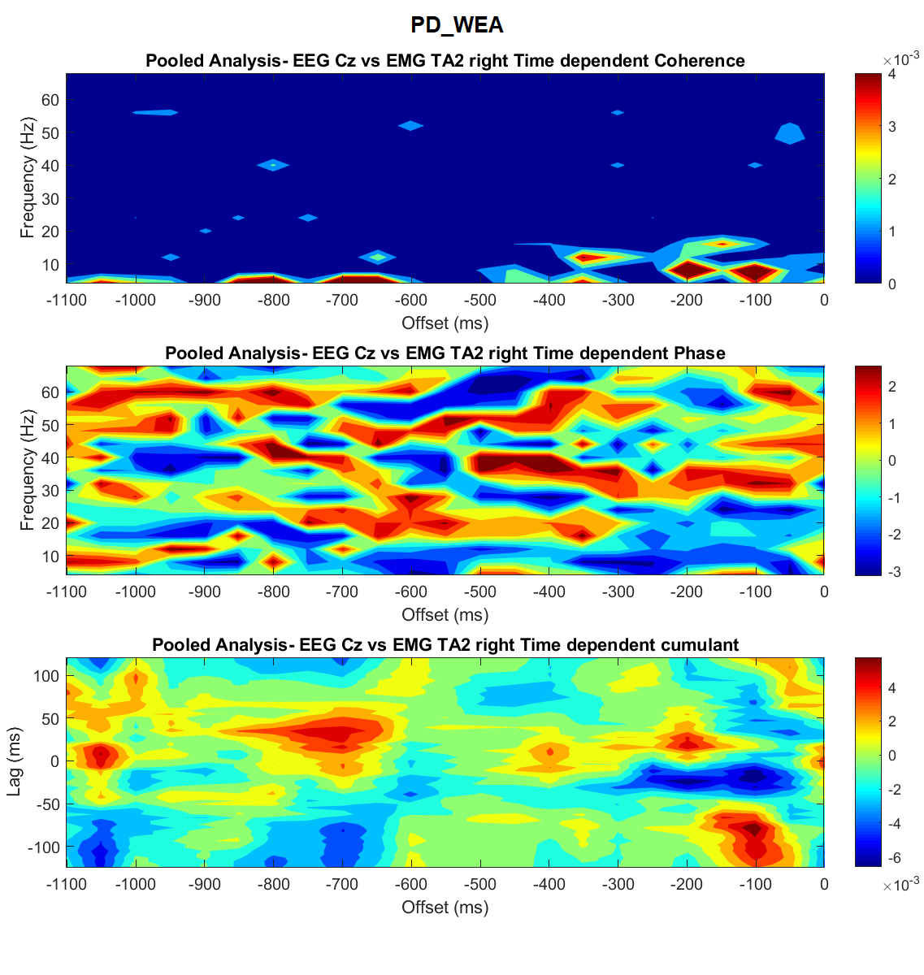
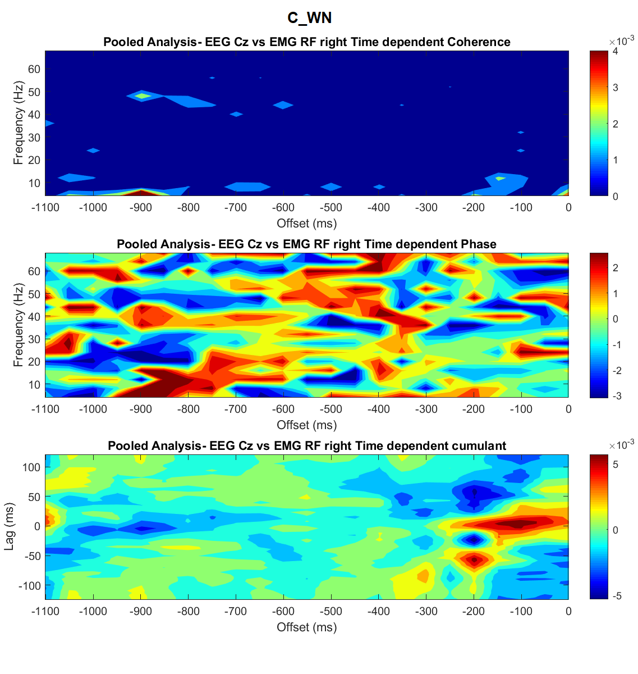
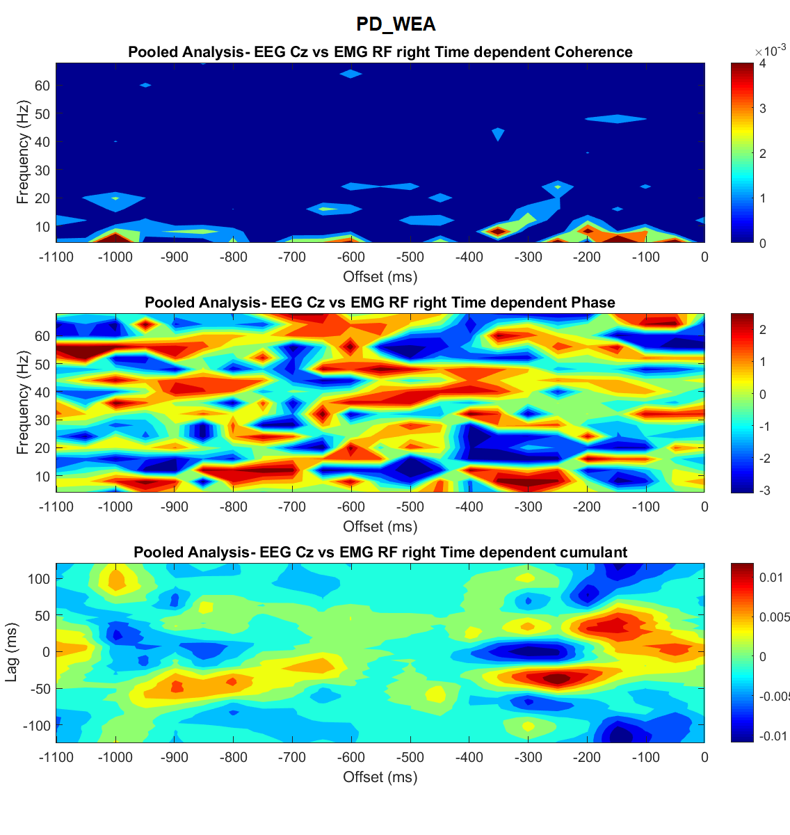
Discussions
Cz vs TA and Cz vs RF,
A bi-directional corticomuscular coupling in both T_{ind} and T_{d} analyses
Cz vs TA
Cz vs RF

Slide 20
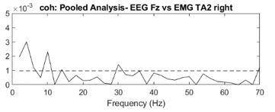
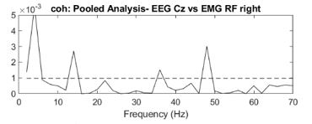
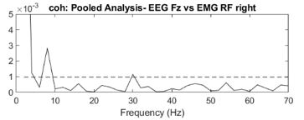
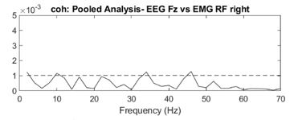
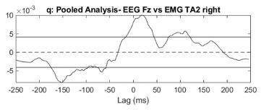
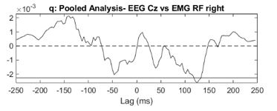
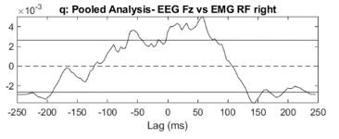
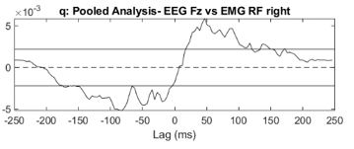
Discussions
2. Is the SMA, directly or indirectly through M1, involved in the activation of leg muscles during gait?
Fz vs TA and Fz vs RF,
A bi-directional corticomuscular coupling in both T_{ind} and T_{d} analyses
C_WN
PD_WEA

Slide 21
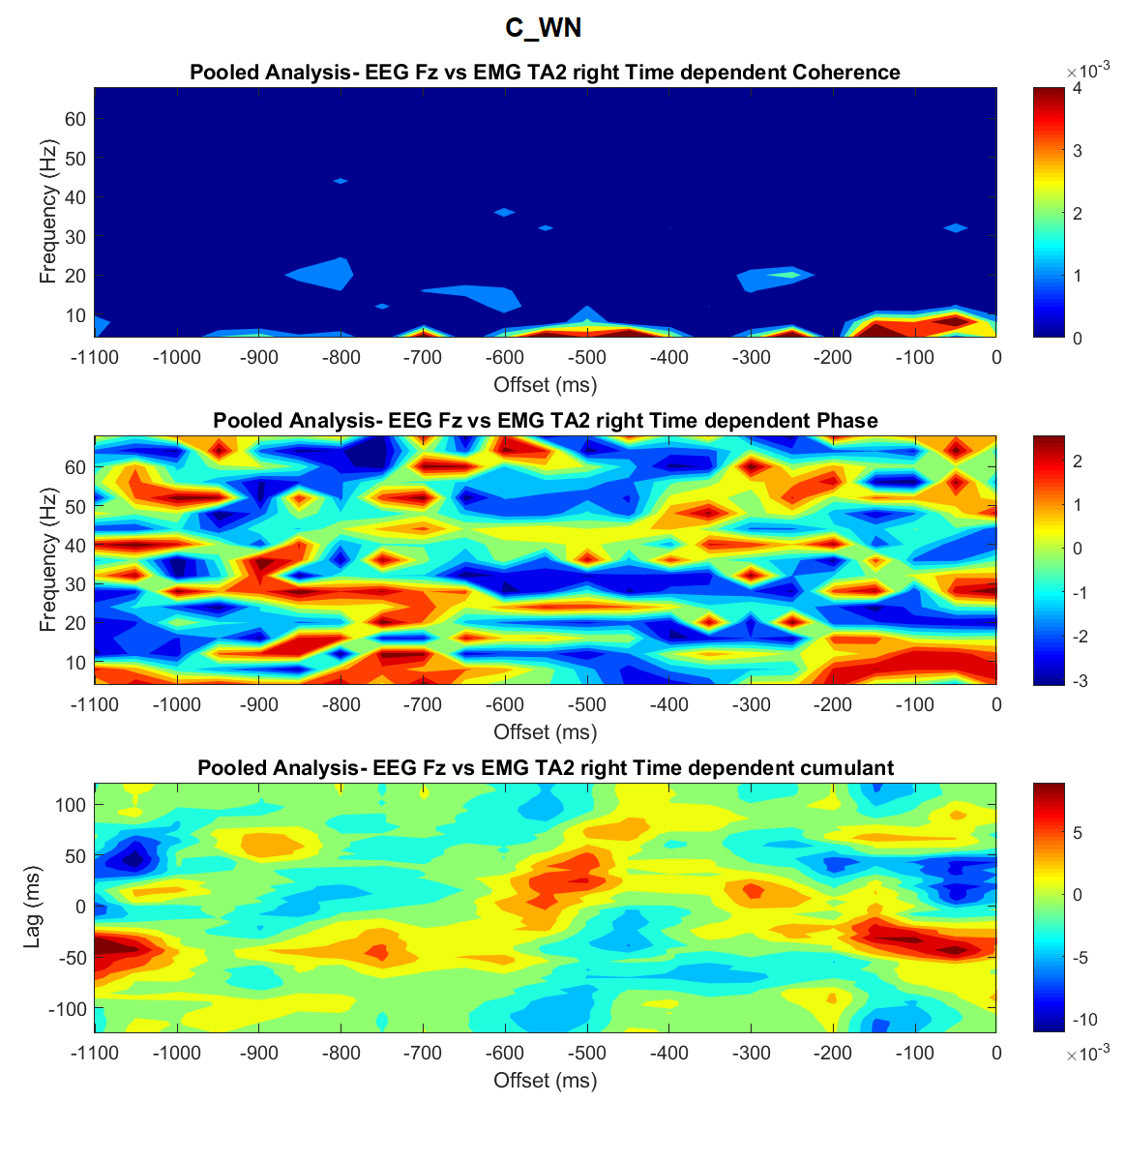
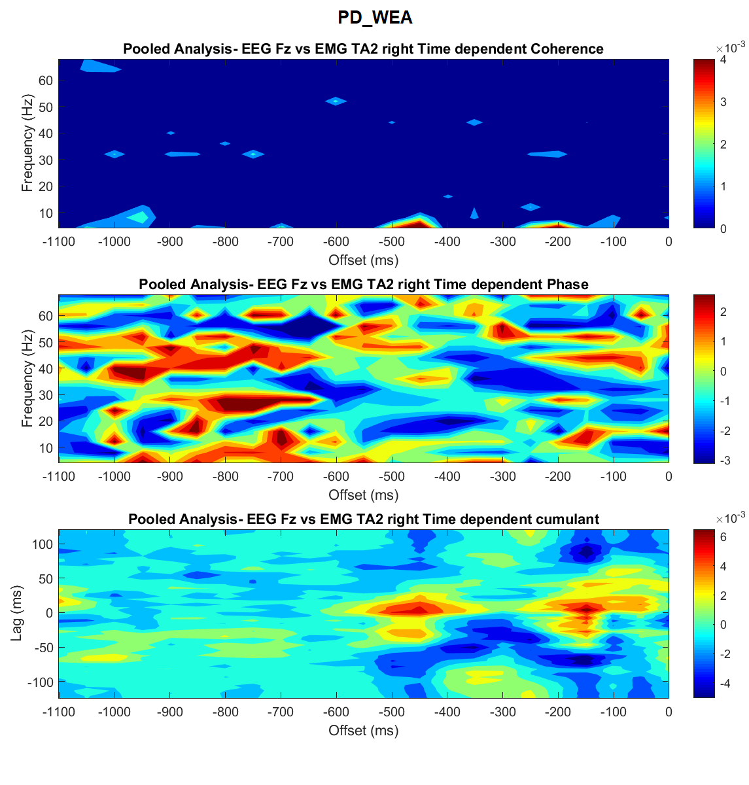
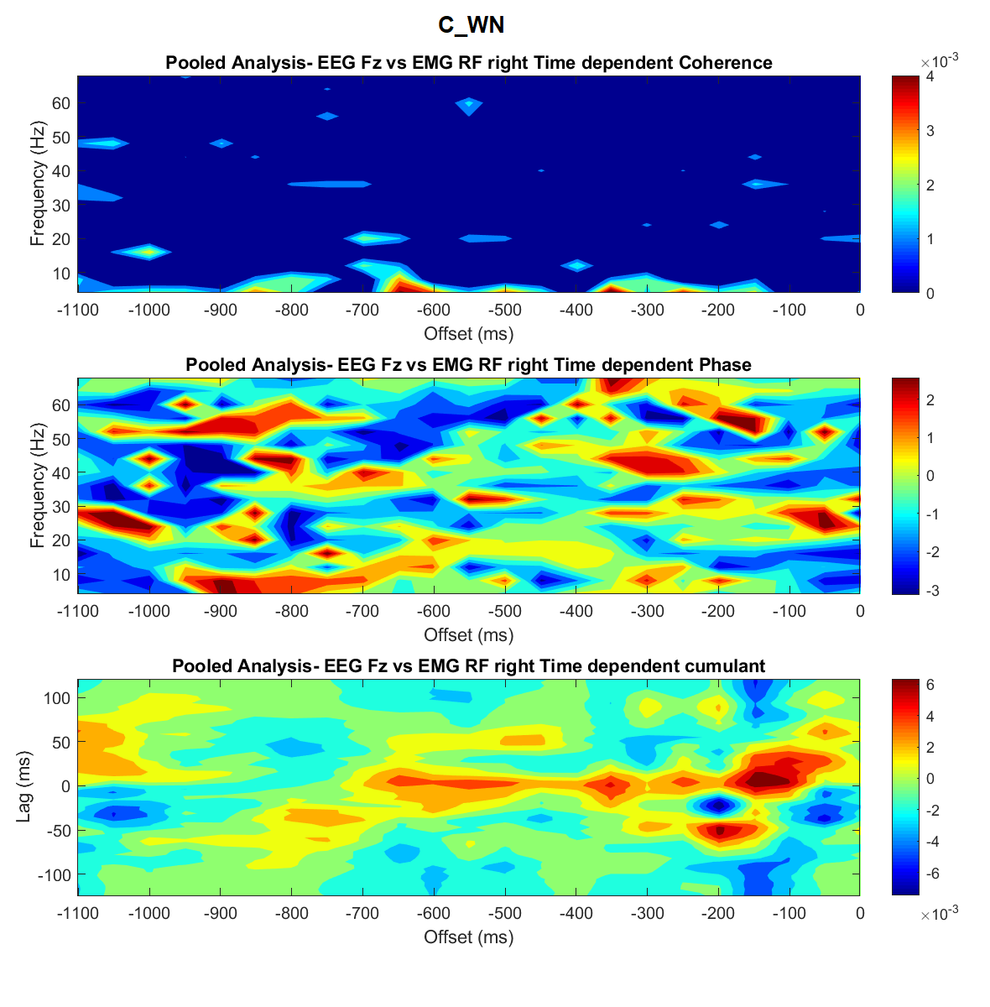
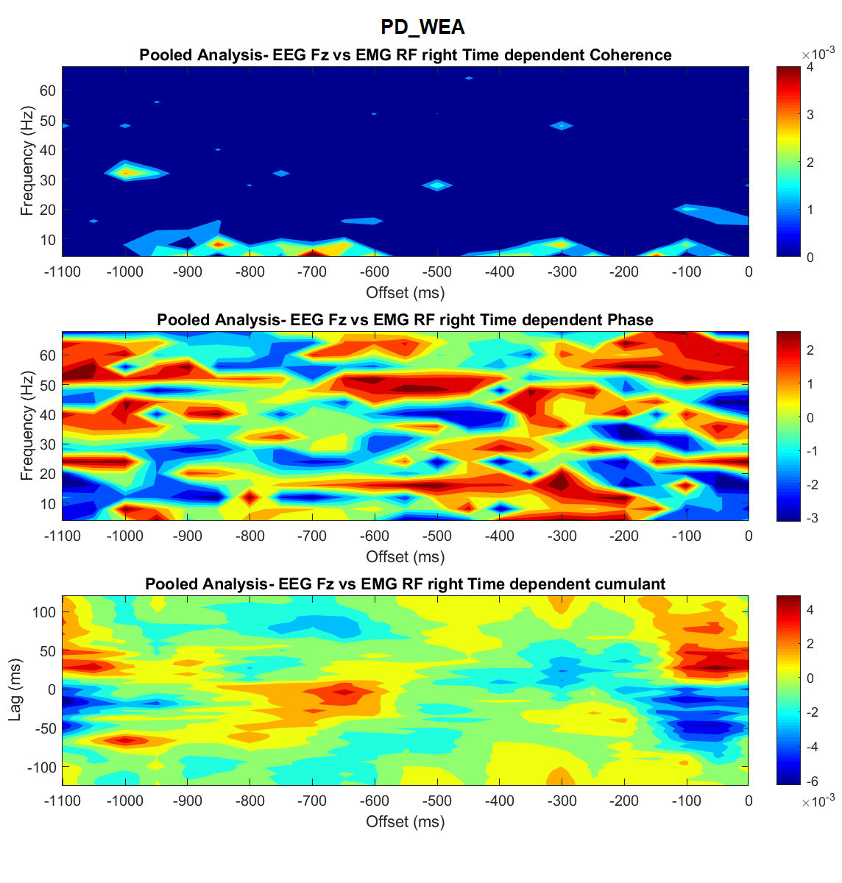
Discussions
Fz vs TA and Fz vs RF,
A bi-directional corticomuscular coupling in both T_{ind} and T_{d} analyses
Fz vs TA
Fz vs RF

Slide 22
Discussions
3. Are SMA and M1 involved in activation of arm muscles during gait related arm swing?
Figure : Shows T_{d} coherences for the four groups for cortical region Fz and muscle DA of the left shoulder.

Slide 23
Discussions
3. Are SMA and M1 involved in activation of arm muscles during gait related arm swing?
Figure : Shows T_{d} coherences for the four groups for cortical region C4 and muscle DA of the left shoulder.

Slide 24
Discussions
4. Comparison of Coherence : Cz vs TA and Fz vs TA,
Figure : Shows T_{d} comparison of coherences for the four groups for cortical region Cz and muscle TA of the right leg.

Slide 25
Discussions
5. Comparison of Coherence : Cz vs TA and Fz vs TA,
Figure : Shows T_{d} comparison of coherences for the four groups for cortical region Fz and muscle TA of the right leg.

Slide 26
Discussions
4. Non-linear analysis
5. Understanding phase and cumulant density estimates where coherence is significant
6. Normalization of data

Slide 27

Future Work
To look into the T_{ind} plots of interesting areas of T_{d} plots for directionality analysis
Implementing higher order cumulants

Slide 28
Questions?

Slide 29
Thank You !

